Slide 1

8th Grade Math: Pre-Algebra
Unit 12, Lesson 9 Evaluating Real-World Problems Using the Order of Operations– Part 1 Volume 2, pg. 256

Slide 2


Benchmark
MA.8.NSO.1.7
Solve multi-step mathematical and real-world problems involving the order of operations with rational numbers, including exponents and radicals.
volume 2, pg. 256

Slide 3
Integrated Mathematical Thinking and Reasoning Standards
MA.K12.MTR.1.1 Actively participate in effortful learning both individually and collectively.
MA.K12.MTR.3.1 Complete tasks with mathematical fluency.
MA.K12.MTR.7.1 Apply mathematics to real-world contexts.
volume 2, pg. 256

Slide 4

Learning Target
I can solve real-world problems involving the order of operations with rational numbers, including exponents and radicals.
volume 2, pg. 256

Slide 5

Warm-Up
volume 2, pg. 257

Slide 6
12.9.1 Warm-Up: FAILure Is an Option
Mark Cuban is an American billionaire entrepreneur. He is the owner of an NBA team, the Dallas Mavericks, and one of the investors on the reality show Shark Tank.
He has been quoted as saying, “I wouldn’t be where I am now if I didn’t fail…a lot. The good, the bad, it’s all part of the success equation.”
Failing can be when you try something that doesn’t work out, but it can also be an opportunity.
Consider the following acronyms for F.A.I.L.
First Attempt In Learning
Forever Acquiring Important Lessons
First Action In Learning
volume 2, pg. 257

Slide 7
Star the acronym you connect with most.
How can thinking about failure in this way be motivating?
Create your own acronym to remind you that failure is just “part of the success equation.”
volume 2, pg. 257

Slide 8

Collaboration
volume 2, pg. 257

Slide 9

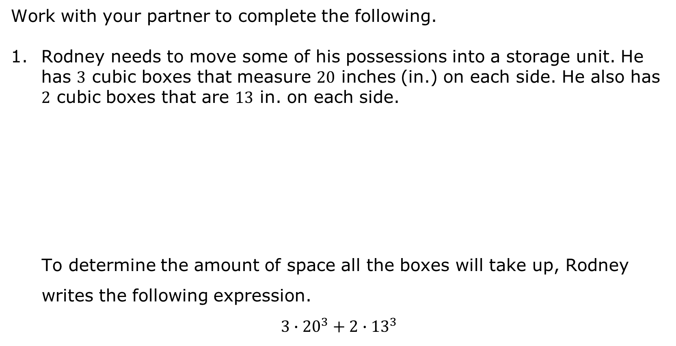
12.9.2 Collaboration: Applying the Order of Operations for Expressions in Real-World Contexts
Work with your partner to complete the following.
Rodney needs to move some of his possessions into a storage unit. He has $3$ cubic boxes that measure $20$ inches (in.) on each side. He also has $2$ cubic boxes that are $13$ in. on each side.
To determine the amount of space all the boxes will take up, Rodney writes the following expression.
$$3∙{20}^{3}+2∙{13}^{3}$$
volume 2, pg. 257

Slide 10
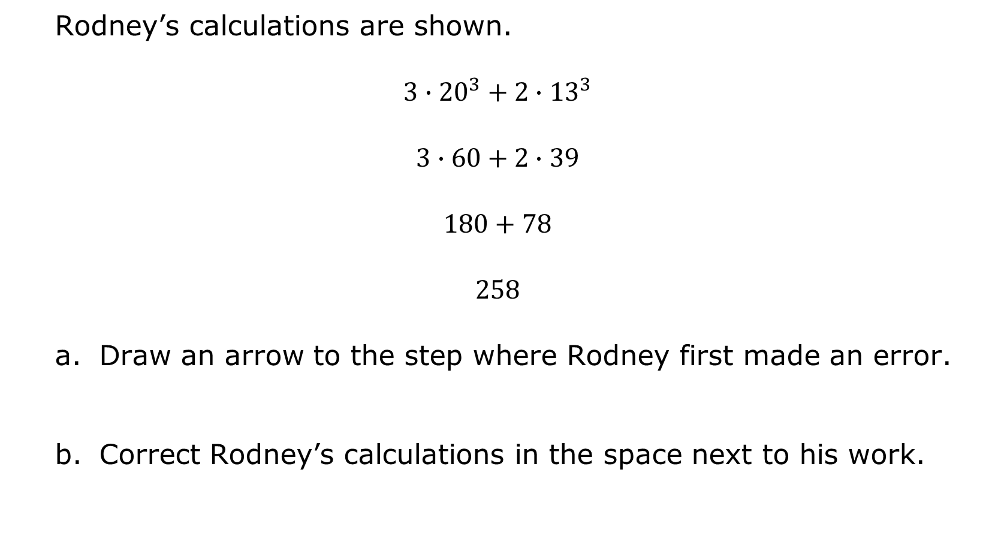
Rodney’s calculations are shown.
$$3∙{20}^{3}+2∙{13}^{3}$$
$$3∙60+2∙39$$
$$180+78$$
$$258$$
Draw an arrow to the step where Rodney first made an error.
Correct Rodney’s calculations in the space next to his work.
volume 2, pg. 257

Slide 11

How many cubic inches of storage does Rodney need?
Explain whether the smallest storage unit, which is $5$ feet (ft) by $5$ ft by $8$ ft, will be large enough for his boxes.
volume 2, pg. 258

Slide 12

Guided Practice
volume 2, pg. 258

Slide 13

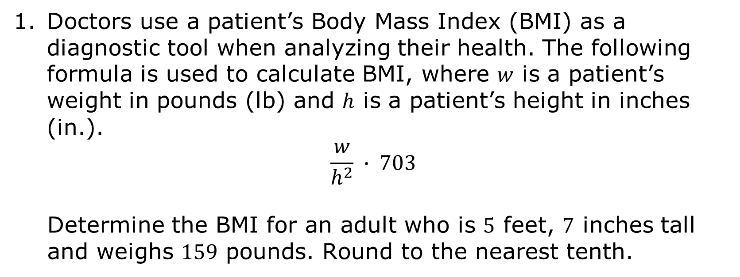
12.9.3 Guided Practice: Applying the Order of Operations Involving Exponents and Radicals for Real-World Contexts
Doctors use a patient’s Body Mass Index (BMI) as a diagnostic tool when analyzing their health. The following formula is used to calculate BMI, where $w$ is a patient’s weight in pounds (lb) and $h$ is a patient’s height in inches (in.).
$$\frac{w}{h^{2}} ∙ 703$$
Determine the BMI for an adult who is $5$ feet, $7$ inches tall and weighs $159$ pounds. Round to the nearest tenth.
volume 2, pg. 258

Slide 14
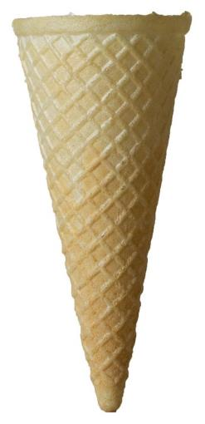
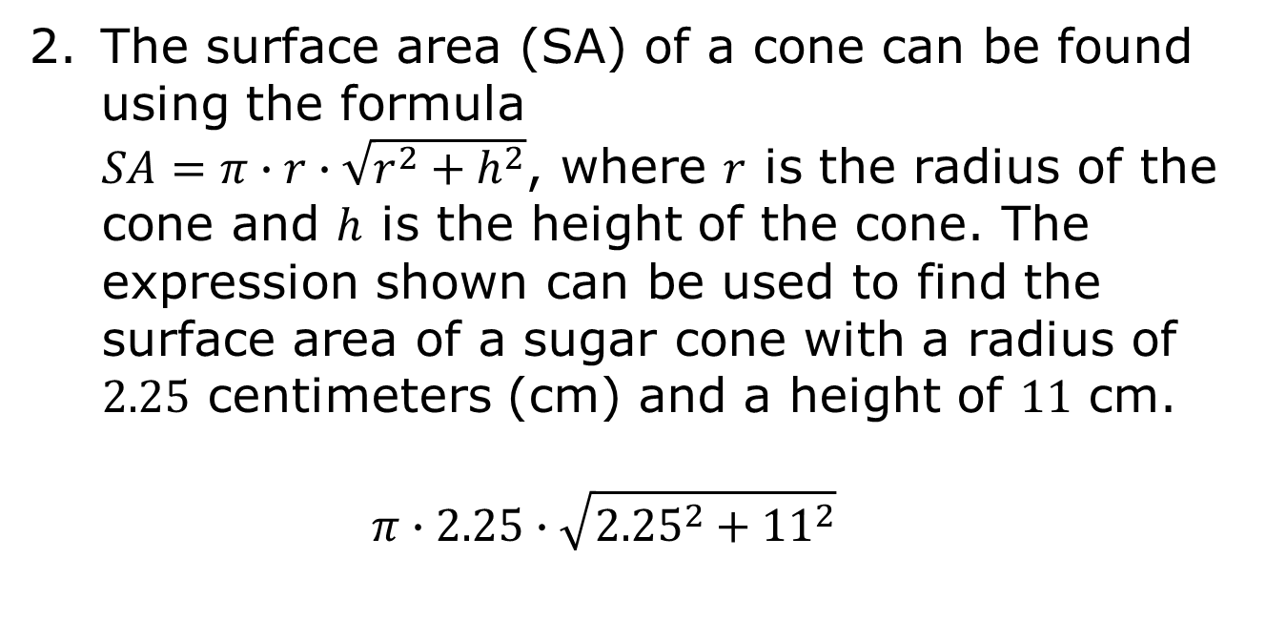
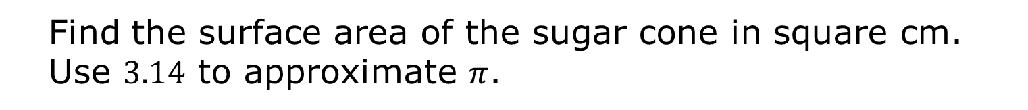
The surface area (SA) of a cone can be found using the formula
$SA=π∙r∙\sqrt{r^{2}+h^{2}}$, where $r$ is the radius of the cone and $h$ is the height of the cone. The expression shown can be used to find the surface area of a sugar cone with a radius of $2.25$ centimeters (cm) and a height of $11$ cm.
$$π∙2.25∙\sqrt{{2.25}^{2}+{11}^{2}}$$
Find the surface area of the sugar cone in square cm. Use $3.14$ to approximate $π$.
volume 2, pg. 258

Slide 15
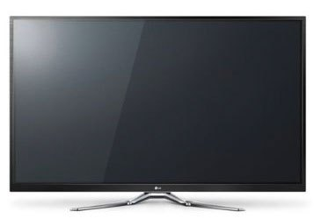
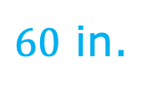
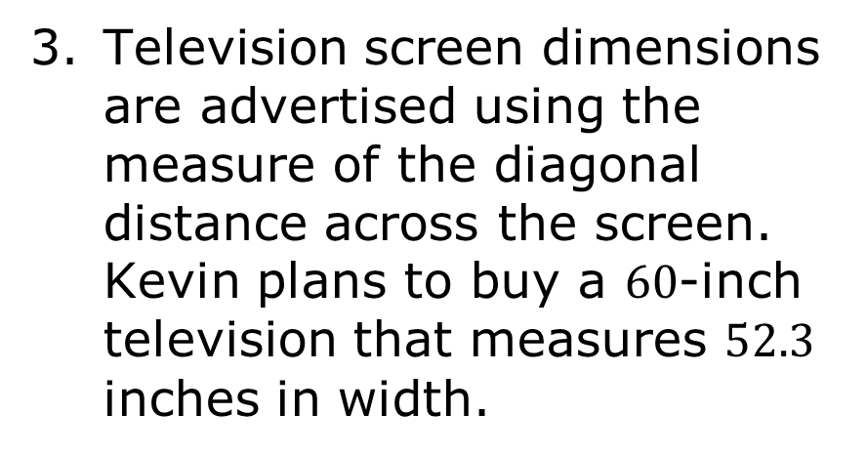
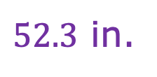
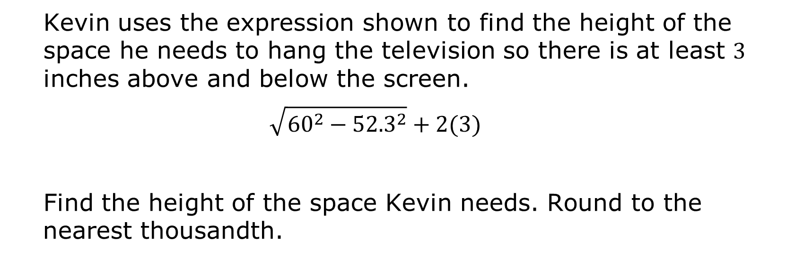
Television screen dimensions are advertised using the measure of the diagonal distance across the screen. Kevin plans to buy a $60$-inch television that measures $52.3$ inches in width.
$60$ in.
$52.3$ in.
Kevin uses the expression shown to find the height of the space he needs to hang the television so there is at least $3$ inches above and below the screen.
$$\sqrt{{60}^{2}−{52.3}^{2}}+2(3)$$
Find the height of the space Kevin needs. Round to the nearest thousandth.
volume 2, pg. 259

Slide 16

Your Turn
volume 2, pg. 259

Slide 17

12.9.4 Your Turn!
Find the value of each expression. Show your work.
${\left(\frac{1}{5}\right)}^{2}∙\left(\sqrt{36}+4\right)$
${(7}^{2}+\sqrt{25})−3.75$
volume 2, pg. 259

Slide 18
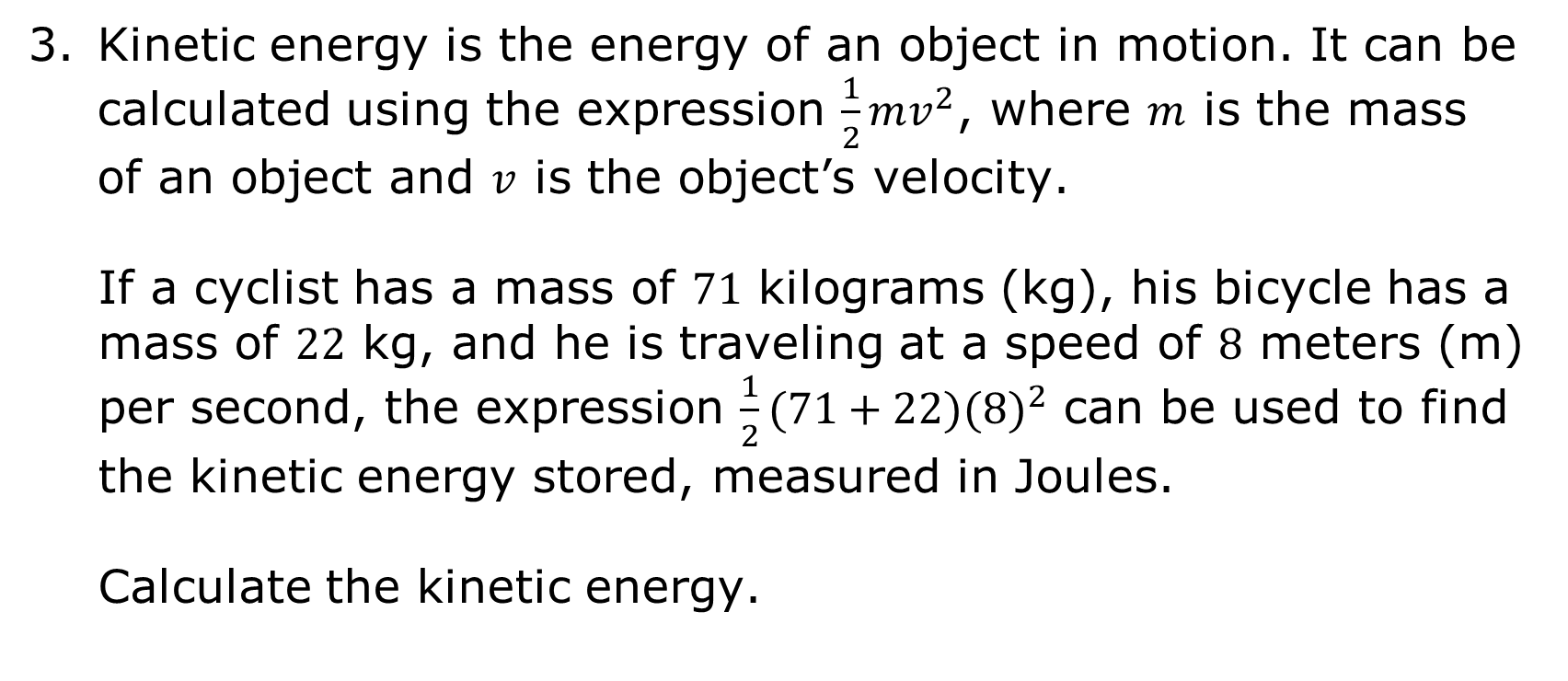
Kinetic energy is the energy of an object in motion. It can be calculated using the expression $\frac{1}{2}mv^{2}$, where $m$ is the mass of an object and $v$ is the object’s velocity.
If a cyclist has a mass of $71$ kilograms (kg), his bicycle has a mass of $22$ kg, and he is traveling at a speed of $8$ meters (m) per second, the expression $\frac{1}{2}(71+22){(8)}^{2}$ can be used to find the kinetic energy stored, measured in Joules.
Calculate the kinetic energy.
volume 2, pg. 259

Slide 19

Wrap-Up
volume 2, pg. 260

Slide 20

12.9.5 Wrap-Up: Reflection
What was the muddiest (most difficult or confusing) point in today’s lesson on evaluating real-world problems using the order of operations?
volume 2, pg. 260

